Slide 1

An Automatic Detection of Breast Cancer using Machine Learning
Department of Computer Science and Engineering
Presented by: Aishwarya MS
1TJ19CS004
TECHNICAL SEMINAR
Under the Guidance of
Ms. ROSE PRIYANKA
Assistant Professor, Dept of CSE
Technical Seminar Co-Ordinator
Ms. Shilpa Sannamani
Assistant Professor, Dept of CSE

Slide 2
CONTENTS
1. Abstract
2. Introduction
3. Background
4. Literature Survey
5. Existing and Proposed Systems
6. Problem Statement
7. Methodology with network architecture
8. Experimental Results
9.Screenshots of Outputs datasets
10.Conclusion

Slide 3
ABSTRACT
Breast cancer is the second most prevalent type of cancer among women, with very high mortality rate.
Breast cancer accounts for 8.4% of diagnosed cancers and 6.6% of cancer-related deaths worldwide, according to a World Health Organization (WHO) report.
Therefore Early Diagnosis and Prognosis will greatly help recovering the livelihood.
This paper introduces a system that uses machine learning and ensemble classifiers to help accurately diagnose and predict breast cancer.
The results showed that the ensemble method had a 98.83% accuracy, outperforming other state-of-the-art methods. This system is highly valuable to the medical industry and related research.
The proposed method was and is better than other existing methods..

Slide 4
INTRODUCTION
Breast cancer is more common in women with dense breasts, and there is a relationship between density and age effects their chances with Breast Cancer.
We will use CAD(computer-aided diagnostic ), comprises three modules: (1) detecting suspicious regions (i.e., by density, micro-calcifications, and mass), (2) extracting features, and (3) eliminating false positive regions.
Breast cancer accounted for 15.9% of all 28.7% reported cancers among Saudi citizens.
The American College of Radiology developed the Breast Imaging Data and Reporting System (BI-RADS). Table presents the four BI-RADS assessment categories.
According to the WCRF, patients identified with stage I/II BC a five-year survival rate of 80-90 percent, while patients diagnosed with stage III/IV BC have a survival rate of only24 percent.
We presented an ensemble of machine learning-based methods for breast cancer diagnosis and prognosis using an ensemble of machine learning classifiers.

Slide 5
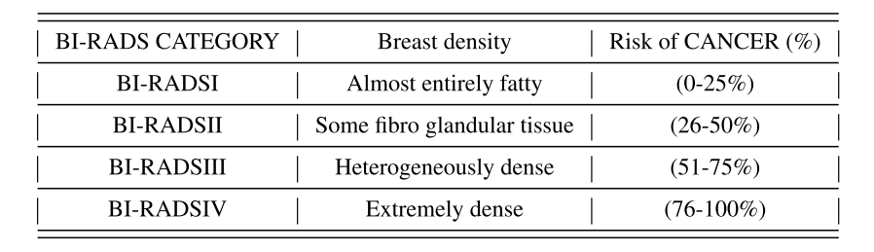
The American College of Radiology developed the Breast Imaging Data and Reporting System (BI-RADS). Table presents the four BI-RADS assessment categories.
BACKGROUND

Slide 6
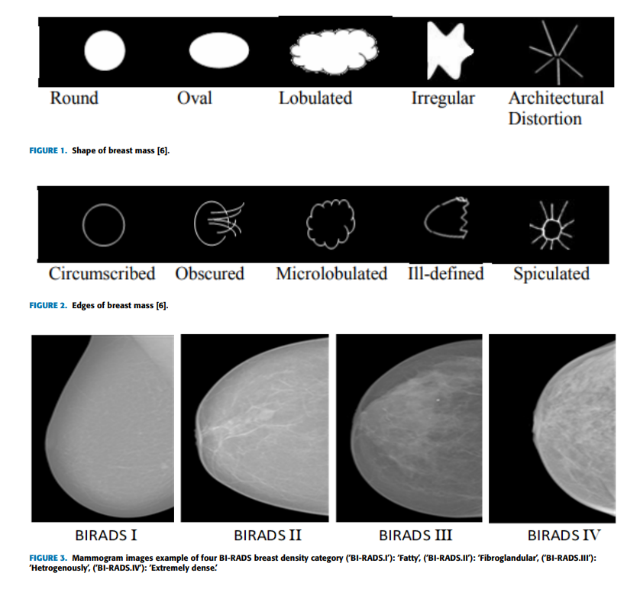

Slide 7
LITERATURE SURVEY
Various automatic systems for breast cancer classification have emerged in recent years, using different approaches.
Breast cancer categorization requires the extraction of discriminatory features and then classification.
State-of-the-art strategies for breast cancer staging have been proposed, including texture-based strategies, signature-based approaches, and ensemble-based algorithms.
Classification and data mining methods are prevalent in the medical field for analysis and diagnosis, including AdaBoost, KNN, and K Tree, neural networks, feature selection methods, and SVM.
Ensemble of classifiers is an essential method to improve the performance of a single classifier.
Different classifiers can be combined to improve the results of breast cancer detection.
Strategy to identify malignant and benign using multiple SVMs.
Using the SVM algorithm, achieved a classification accuracy of 93.26%. The accuracy of an SVM-based classifier reported was 97.60%

Slide 8
Proposed System better than Existing System
Includes the use of An ensemble of four ML-based classifiers, the concatenation of stacked model predictions fed to an ANN model for final prediction, and the use of the K-fold method to retrieve the most common outcome from the classifiers and streamline the training dataset.
Additionally, the proposed system uses several ML classifiers, including SVM, LR, NB, DT, and ANN, whereas the existing system uses only one classifier.
The proposed system's performance is also compared with several ML classifiers individually with and without up-sampling techniques, and with other ensemble models, which the existing system does not offer.
As a result of these differences, the proposed system provides increased accuracy, better performance, and more comprehensive comparisons with other ML models than the existing system.

Slide 9
EXISTING SYSTEM
PROPOSED SYSTEM
The existing system involves manual interpretation of screening mammography images by radiologists.
The process we use one or two different classifiers only
The proposed system uses machine learning (ML) algorithms and an ensemble of classifiers for automatic detection of breast cancer diagnosis and prognosis.
The system offers several advantages over the existing system.
The chances of human error in the detection process are reduced.
It provides a faster and more accurate diagnosis, which can significantly improve the chances of survival.
The proposed system uses an ensemble of classifiers, which outperforms other state-of-the-art methods, achieving an accuracy of 98.83%.
In contrast, the accuracy achieved by different algorithms in the existing system ranges between 94.36% to 99.90%.
The proposed system focuses on the use of artificial neural network (ANN) methods based on deep learning (DL), as well as (SVM) based on traditional machine learning (ML), and (KNN) and (DT) algorithms.
Never before in any system were a combo of (SVM+DT+NB+LR)+ANN was used for diagnosis and prognosis of Breast Cancer.

Slide 10
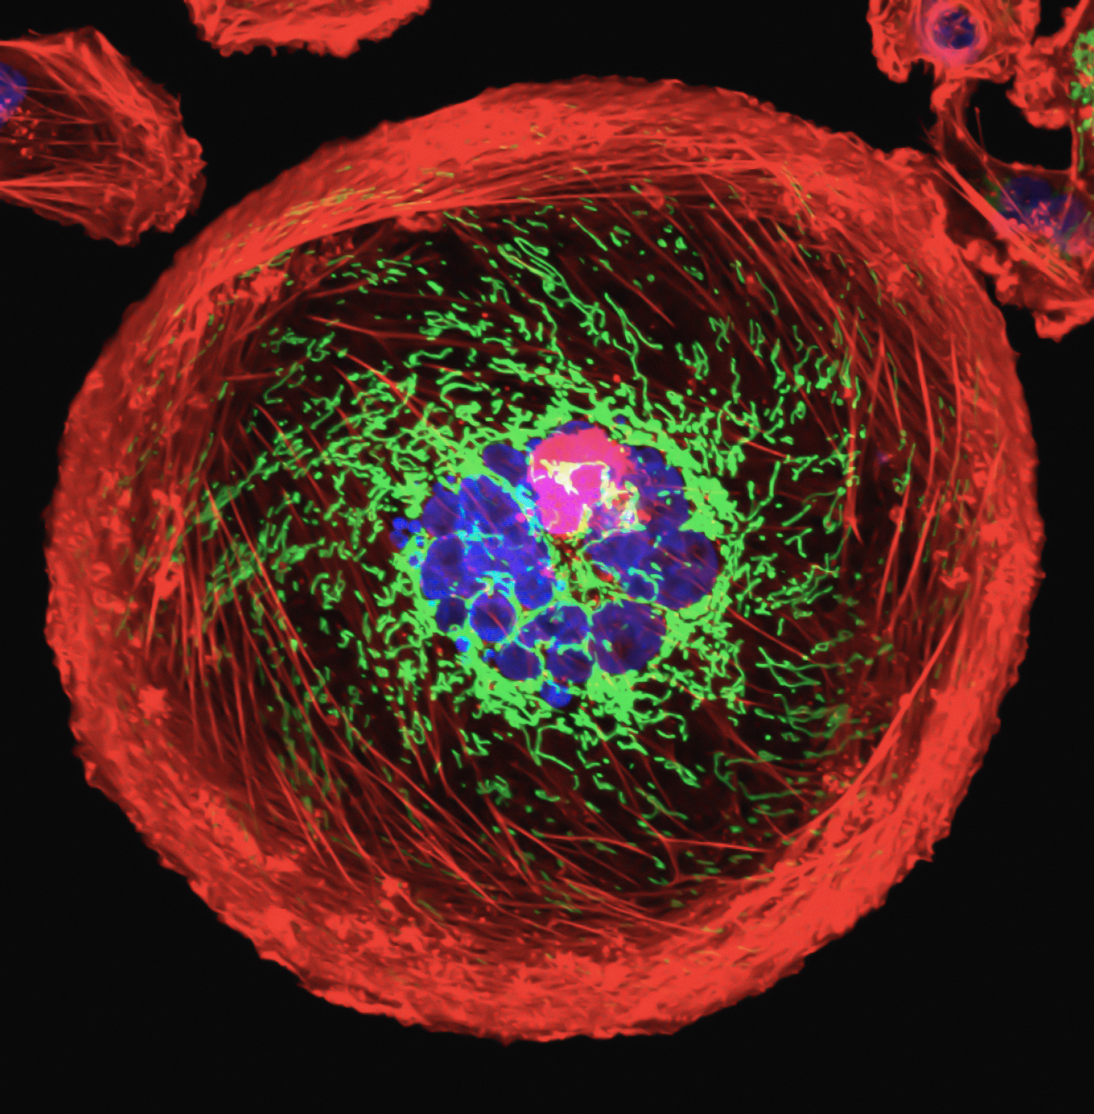
Problem Statement
Finding precise or high accuracy of Diagnosis and Prognosis for Breast Cancer, overcoming the limitations of the models, classifiers, overfitting, that effected the accuracy.

Slide 11
METHODOLOGY
This architecture is composed of four different ML models. They are stacked and then further trained as an ensemble. After training, the ANN model is used for the outcome.
We used machine learning based classifiers on a training dataset
In the second step, the K-fold method retrieves the most common outcome from these classifiers.
In third step, we concatenated results from machine learning classifiers
New training dataset streamlined as a result
In this step, we input the new dataset into the default ANN
Result and evaluation of outputs

Slide 12
Support Vector Machine (SVM)
SVM (Support Vector Machine) is a supervised machine learning algorithm used for classification and regression analysis.
One of the main advantages of SVM is that it solves the restriction of linear limits.
SVM can be considered a two-class data set that can be partitioned linearly to show a maximum hyperplane margin.
SVM has several benefits, including high accuracy, robustness to noise and outliers, and the ability to handle high-dimensional data.

Slide 13
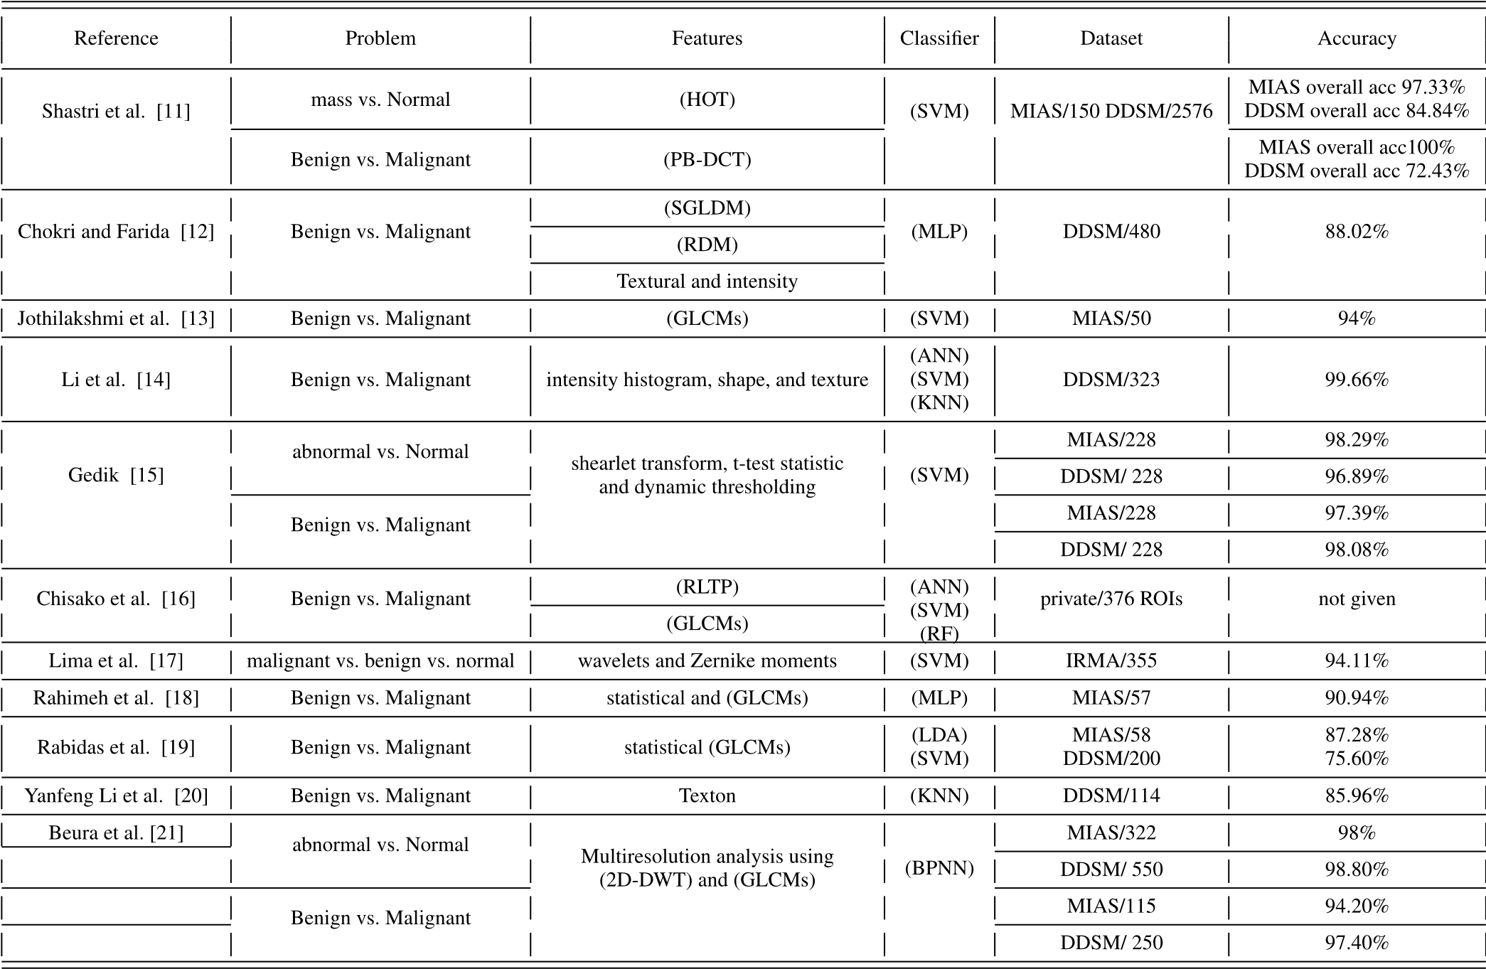
Support Vector Machine (SVM)

Slide 14
Logistic Regression (LR)
LR is a statistical method used for analyzing a dataset in which there are one or more independent variables that determine an outcome.
The LR method is created by replicating the posterior probability of K groups across linear roles in x while ensuring they equal one and stay within the range [0, 1].
Logit shifts K -1, or log probabilities can be used to describe LR
It involves splitting the dataset into K subsets, or "folds", and using K-1 of these folds as the training set for the classifier while using the remaining fold as the test set. This process is repeated K times.

Slide 15
Naive Bayes (NB)
Bayes theorem is used to suggest the NB algorithm
Bayes’ Theorem P (A |B) is calculated as follows:
P(A|B) = P(B|A)*P(A)/P(B)

Slide 16
Decision Tree (DT)
DT that begins with huge groupings of specimens within clearly defined categories.
To determine the ‘goodness’ of a test, the C4.5 calculus uses equations based on theoretical data;
The limitation of DT is how to handle the issue of over-fitting and unknown values. C4.5 method of DT can address the issue of unknown values, especially the samples with unknown values are ignored.

Slide 17
Artificial Neural Network (ANN)
Greatly, the network has enabled great success, especially in BC classification and early-stage prognosis.
ANN models usually have three layers: input, hidden, and output
First, the input layer gets the data, then passes it to a hidden layer for analysis and returns the results to the output layer. Results shows are now displayed through the output layer.
There are three dense layers and two dropout levels in the ANN structure used in this study

Slide 18
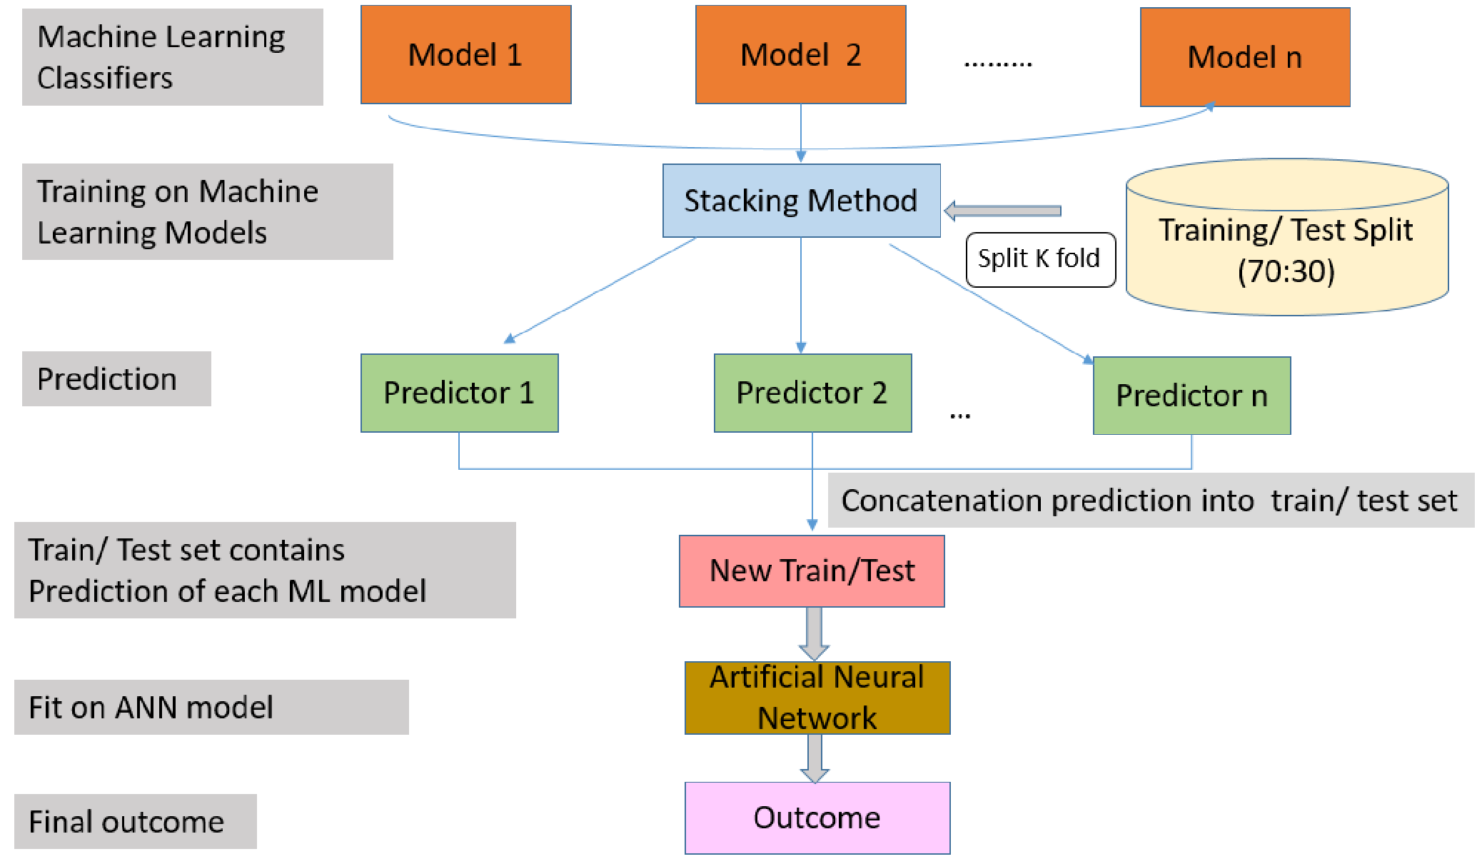
Illustration of the proposed network architecture.

Slide 19
EXPERIMENTAL RESULTS
DATASET DETAILS: The Breast cancer Wisconsin (Diagnosis)1 and Breast cancer Wisconsin (Prognosis)2 databases are used in this study of Dataset distribution.
EVALUATION METRIC is All reported results are the average results
Accuracy = Number of correct predictions / All samples

Slide 20
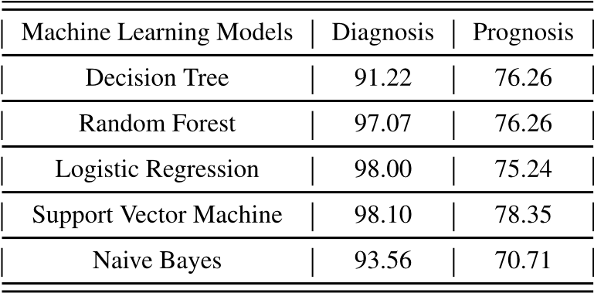
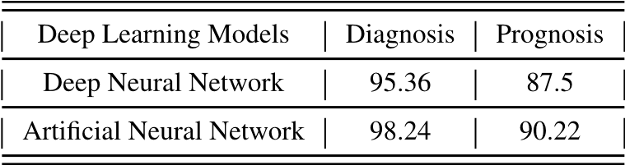
Comparison of ML classifiers. Average accuracy (%) is reported as evaluation metric.
OUTPUT
Comparison of DL classifiers.
SVM outperforms all ML-based classifiers on both diagnosis BC with 98.10% accuracy and prognosis BC dataset with 78.35% accuracy. In contrast, the worst classifier on the diagnosis dataset is DT with 91.22% accuracy and NB on the prognosis dataset with 70.71%. For DL-based classifiers;ANN performs well on both datasets, with 98.24% accuracy on the diagnosis dataset and 90.22% accuracy on the prognosis dataset.

Slide 21
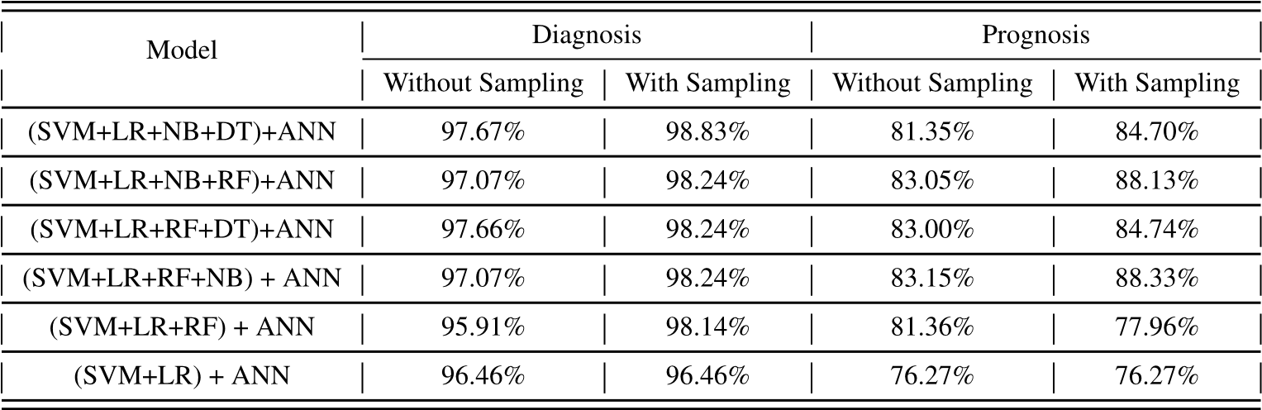
OUTPUT Ensemble of ML classifiers with ANN with and without sampling
The best ensemble model is the ensemble of (SVM + LR + NB + DT) in both cases (without 97.67% and with up-sampling 98.83%). In contrast, the worst-performing combination is (SVM+LR+RF) in both cases (95.91% for without sampling and 98.14% for up-sampling) on the diagnosis dataset.

Slide 22
CONCLUSION
The study proposes a method for breast cancer diagnosis and prognosis using machine learning techniques.
Benchmark datasets were used to evaluate the performance of different classifiers based on machine learning and deep learning.
Support Vector Machine (SVM) outperformed other ML classifiers and Artificial Neural Network (ANN) from DL classifiers when used individually.
Ensembles of different ML-based classifiers were tested and (SVM + LR + NB + DT) performs well on the diagnosis dataset, whereas (SVM+LR+RF+NB) outperforms all other combinations on the prognosis dataset.
Balanced class weights and upsampling technique can further improve the performance of the classifiers.
Overall, the study demonstrates the potential of machine learning techniques for breast cancer diagnosis and prognosis, and provides insights into the most effective methods for classification.

Slide 23
REFERENCES
[1]Cancer Burden Rise to 18.1 Million New Cases and 9.6 Million Cancer Deaths in 2018, International Agency for Research on Cancer, World Health Organization, Geneva, Switzerland, 2018, p. 3.
[2] W. S. Alqahtani, N. A. Almufareh, D. M. Domiaty, G. Albasher, M. A. Alduwish, H. Alkhalaf, B. Almuzzaini, S. S. Al-Marshidy, R. Alfraihi, A. M. Elasbali, and H. G. Ahmed, ‘‘Epidemiology of cancer in Saudi Arabia Thru 2010–2019: A systematic review with constrained meta-analysis,’’ AIMS Public Health, vol. 7, no. 3, p. 679, 2020.
[3] J. Wei, H.-P. Chan, Y.-T. Wu, C. Zhou, M. A. Helvie, A. Tsodikov, L. M. Hadjiiski, and B. Sahiner, ‘‘Association of computerized mammographic parenchymal pattern measure with breast cancer risk: A pilot casecontrol study,’’ Radiology, vol. 260, no. 1, pp. 42–49, Jul. 2011.
[4] G. Litjens, T. Kooi, B. E. Bejnordi, A. A. A. Setio, F. Ciompi, M. Ghafoorian, J. A. V. D. Laak, B. V. Ginneken, and C. I. Sánchez, ‘‘A survey on deep learning in medical image analysis,’’ Med. Image Anal., vol. 42, pp. 60–88, Dec. 2017.
[5] M. Milosevic, D. Jankovic, A. Milenkovic, and D. Stojanov, ‘‘Early diagnosis and detection of breast cancer,’’ Technol. Health Care, vol. 26, no. 4, pp. 729–759, 2018.

Slide 24

THANK YOU

